Slide 1
Kirill Lozinskiy NERSC Storage Systems Group
GPFS
&
HPSS
Interface (GHI)

Slide 2
Topics
Overview
IBM Spectrum Scale | General Parallel File System (GPFS)
High Performance Storage System (HPSS)
GPFS/HPSS Interface (GHI)
GPFS HSM space management with ILM
GPFS disaster recovery
Birds of a Feather (BoF)

Slide 3
Overview

Slide 4
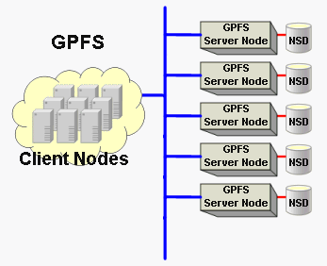
IBM Spectrum Scale General Parallel File System (GPFS)
What is GPFS?

Slide 5
IBM Spectrum Scale General Parallel File System (GPFS)
What is GPFS?
A true parallel and clustered file system
Performance and scalability
Transparent cloud tiering
Simplified administration
Information Lifecycle Management (ILM) policy scans
And more. . .

Slide 6
HPSS?
What is HPSS?

Slide 7
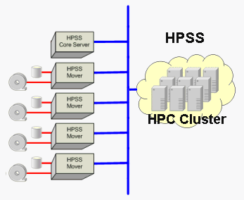
High Performance Storage System (HPSS)
Hierarchical storage manager (HSM)
Disk
Tape
Object
HPSS system components
HPSS Core Server
HPSS Data Mover
Primarily tape oriented
Designed for very large (exascale) HPC storage
Developed in collaboration by five DOE Labs and IBM

Slide 8
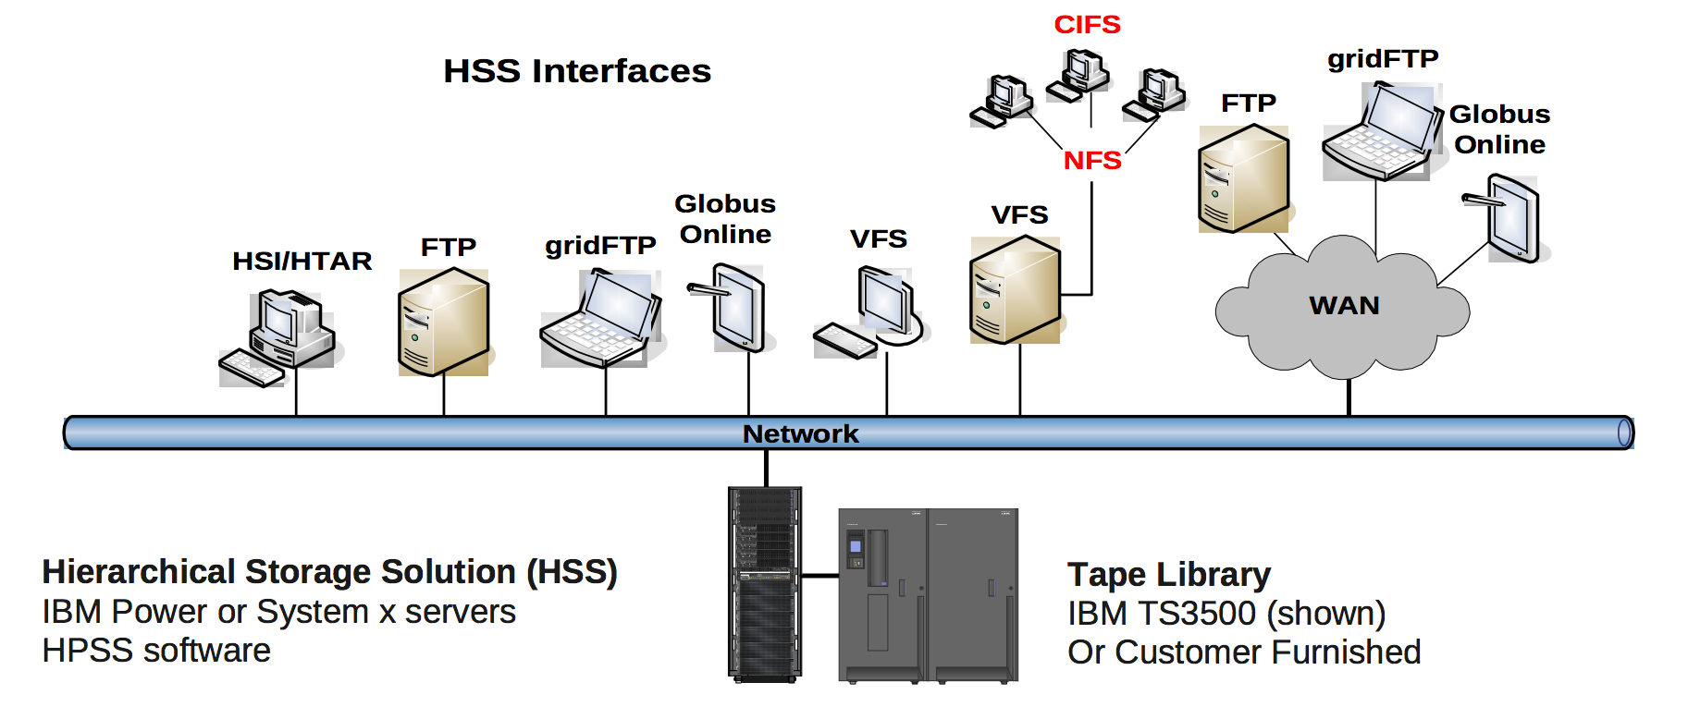
High Performance Storage System (HPSS)
Data protection
Redundant Array of Independent Tapes (RAIT)
Mirroring
Clients

Slide 9
Who uses HPSS?

Slide 10
High Performance Storage System (HPSS)
First NERSC deployment in 1998
100+ PB of data
Over 230 million files
~ 5 PB of disk cache
Grows at more than 1 PB per month
40 years of scientific data

Slide 11
GPFS/HPSS Interface (GHI)

Slide 12
GPFS/HPSS Interface (GHI)
GHI primary functions
Space management
Migrate
Purge
Recall
Disaster recovery
Backup
Restore

Slide 13
GPFS/HPSS Interface (GHI)
GPFS HSM space management / file migrations
GPFS Data Management API (DMAPI) notifies GHI of events
HPSS references are stored as GPFS extended attributes
GPFS ILM scans and policies
ILM scans billions of files in minutes
Files are continuously identified and migrated/purged/recalled to/from HPSS per policy
If GPFS reaches a space threshold, candidates are purged
When a user requests a file in HPSS, GHI stages it back
Small files are aggregated with a tar like utility to improve performance
Policy rules provide robust data management solutions

Slide 14
GPFS/HPSS Interface (GHI)
GPFS disaster recovery
Provides continuous backup via GPFS snapshots
Stores a snapshot of an entire GPFS cluster
Namespace
File attributes
ACLs
DMAPI attributes
Restore aims to bring GPFS back as fast as possible
ILM stages files back based on specified priority

Slide 15
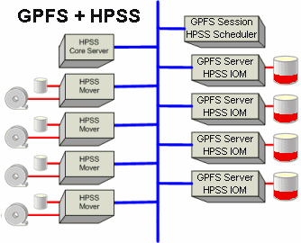
GPFS/HPSS Interface (GHI)
http://www.hpss-collaboration.org/hpss_for_gpfs.shtml

Slide 16
Birds of a Feather

Slide 17
National Energy Research Scientific Computing Center

